Slide 1
Faculty Liberal Arts Advisor Pilot Program
Informational Session | April 3, 2026
School of Arts & Sciences | Dartmouth College

Slide 2
Why Rethink Pre-Major Advising at Dartmouth?
~33%
of students report satisfaction with pre-major advising—a 25-year trend
~50%
of interest-based advisor matches are non-exact
0
peer institutions support interest-based pre-major advising as best practice
~70-80%
of students are matched to their House Community
~80-90%
Student satisfaction with the Faculty of Arts and Sciences at Dartmouth College
Interests Change
from Common App to Admission decision to Matriculation
Liberal Arts
Dartmouth intentionally messages exploring the liberal arts
Untapped
House Communities offer a rich site for academic advising and for building intellectual community

Slide 3
Liberal Arts Focused, House Community-Centered Cohort Model
20 Faculty Advisors × 20 Students each
~400 first-year students across 2 House Communities
Curricular Generalists
Trained to advise across all disciplines—no need to be a specialist, focused on exploration, problem-solving, and agency development
House-Based Cohorts
Advisors embedded in residential communities where students live
Pre-Matriculation Through Year 2
Follow students from orientation to major declaration, focusing on transitions
Affinity Advising Preserved
Engineering, Athletics, FGO programs stay in place; students and advisors have clearer sense of each student’s advising ecosystem
Remaining ~800 incoming students continue under the current system as a comparison group in AY 26–27
Notes:
Yes to name houses, does not preclude outside of pilot
May move houses, gives some agency/choice
want to build meaningful house connections, for faculty and students

Slide 4
Commitment as Liberal Arts Faculty Advisor
Compensated | ~60–70 hours over the full academic year (Summer ’26–Spring ’27)
New Student Orientation
(Optional) NSO curriculum development over the summer
Late Summer two-day mini-retreat in preparation of student arrival
Meet students on move-in day (Sept 2)
Intellectual Community Days (Sept 4 & 8)
First group meeting with advisees & UGA (Sept 10)
Advising Day (Sept 11)
Student Meetings
Individual meetings each course election period (3x/year)
Off-cycle meetings as needed
Coordinate with undergraduate deans
Engage with the floor UGA(s) of your first-year advisees
Community Integration
Group check-in meals each term in the House
Optional: invite guest lecturers, hold write-ins, discussions with house faculty, or any other ideas to improve intellectual community!
Evaluation
Termly meetings with deans and Advising director to share observations
Pilot feedback sessions with the advising team
End-of-year debrief and celebratory luncheon
Requires availability for Late August two-day half day mini-retreat; for New Student Orientation, and for meetings Fall 2026, Winter 2027, and Spring 2027
Compensation is $6,000 per year as summer salary or SSR for T/TT faculty;
$6,000 per year and .17FTE in contracts for teaching faculty

Slide 5
Training & Support
You won’t be on your own. No prior advising experience required.
Spring 2026
Optional Planning
Informational meetings and early cohort building
Late Summer 2026
Core Training Retreat
Advising best practices, soft skills, generalist training, pilot goals
Each Term
Ongoing Sessions
Skill development, resources, and Q&A with the advising team
Year-Round
Collaborative Support
Cohort of 20 faculty working together across two Houses
Training covers: liberal arts advising philosophy, curricular requirements, academic planning tools, navigating student challenges, and coordination with UDO

Slide 6
Timeline & What Comes Next
Spring 2026
Applications open
Training design
House selection
Fall 2026
Pilot launches
~400 students
20 advisors in 2 Houses
Fall 2027
Full launch
All incoming students
Revised model
Summer 2026
Core training retreat
Student matching
Orientation prep
Winter–Spring 2027
Assessment
Iteration planning
Scale recruitment
Applications open now, rolling review starts April 6

Slide 7
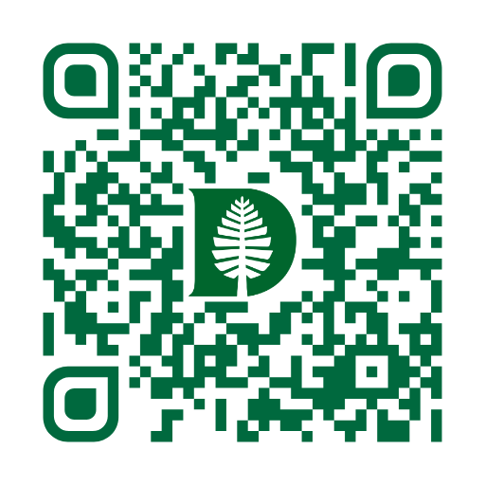
Get Involved
Apply at dartgo.org/advising_pilot
Rolling review begins April 6, 2026
Reach out to us
Advising Group Members: Scott Pauls, Mary Nyhan, Natalie Hoyt, Ryan Hickox, Francine A’Ness, Tim Baker
More Questions?
Tim Baker
tbaker@dartmouth.edu
Open to All Faculty
Tenure-line and teaching faculty
No prior advising experience needed
Findings from this pilot will directly shape the future of advising at Dartmouth.
We hope you’ll consider joining us in this meaningful work.

